Slide 1
Enhancing AES S-Box Generation Based on Round Key
Based on:
“Enhancing Advanced Encryption Standard S-Box Generation Based on Round Key”
Vol. 1 No. 3- International Journal of Cyber-Security and Digital Forensics (IJCSDF)
-Julia Juremi, Ramlan Mahmod, Salasiah Sulaiman, Jazrin Ramli
Faculty of Computer Science and Information Technology, University Putra Malaysia
Presented By,
Arjun B. Varghese
130948004
MTech CSIS 2013-15

Slide 2
Outline
INTRODUCTION
AES Algorithm
Existing Design
Sub Byte/Inverse Sub Byte Transformation
Proposed New Design
Key Dependent S-Box Generation
Evaluation Criteria
Future Enhancement
Conclusion

Slide 3
Introduction
Encryption : Converting a message into coded form
Decryption : Reverse process
Plaintext : Message to be encrypted
Cipher : Coded message obtained
Key is used for encryption
Encryption Algorithm: Tool for Encryption.
It performs various substitutions and transformations to the plaintext to covert it into the cipher.
Stream cipher- Reading a stream of input and converting each bit into corresponding bit cipher
Block cipher- It converts a block of data as a whole to an cipher output block.

Slide 4
AES Algorithm
Advanced Encryption Standard
Rijndeal Cipher submitted by Joan Daemen and Vincent Rijmen was elected as the winner of the competition conducted by NIST(National Institute of Standards and Technology) (to replace DES) and it became the advanced encryption standard in 2001 December.
Supports keys of lengths 128, 192, and 256 bits
AES can process data blocks of size 128 bits
Input is 128 bit block
Large data will be split into 128 bit blocks and fed into the algorithm
AES uses a sequence of rounds for processing the block
Number of rounds can be 10/12/14. It depends on the length of key.
Each Round consists of Different stages

Slide 5
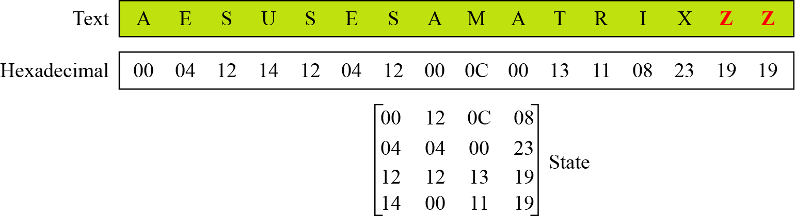
We will consider
128 bits block cipher
128 bit length key
10 rounds
Input data block is depicted as a square matrix of bytes (state array)
It will be modified at each stage of encryption or decryption.
Figure 1. Representation of Input block. State Matrix

Slide 6
128 bit input key will be given
Each round needs separate 128 bit keys
Key scheduling algorithm produces 128 bit key for each round by expanding the input key

Slide 7
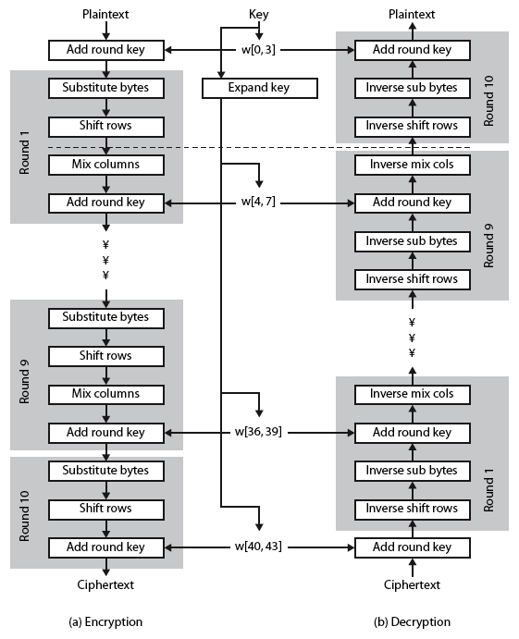
Figure 2. AES Algorithm

Slide 8
Rounds
Starts with add round key
Followed by 9 rounds of following stages
Substitute bytes
Shift rows
Mix columns
Add round key
These stages will be repeated for 9 rounds
Last round consists only 3 stages

Slide 9
Stages
Substitute Bytes
Substitute for the byte in the state matrix, another byte from the S Box.
Provides confusion(substitution)
Shift Rows
Bytes in the last three rows of the states are cyclically shifted.
Shifting is based on the row number
Provides Diffusion(permutation)
Mix Columns
The state matrix is multiplied with a fixed matrix.
Diffusion
Add Round Key
XOR each byte of the state and the round key
Confusion

Slide 10
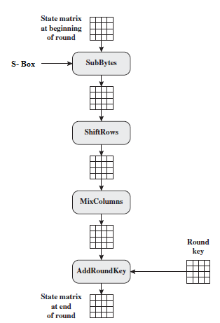
Existing AES Design
Figure 3. Existing AES One Round

Slide 11
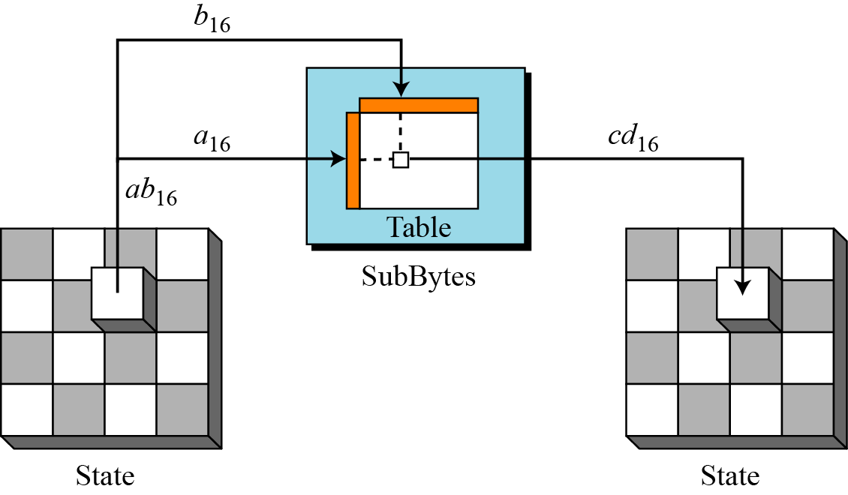
Sub Bytes / Inverse Sub Bytes Transformations
It uses a fixed S Box for the substitution
Each byte in the state is replaced with its entry in the S-box
To substitute a byte, we interpret the byte as two hexadecimal digits
For eg. Consider a hex byte, say C2 of the state.
25(Hex) = S-box(C2)
2
C
25
C2
25
Figure 4. Substituting Bytes

Slide 12
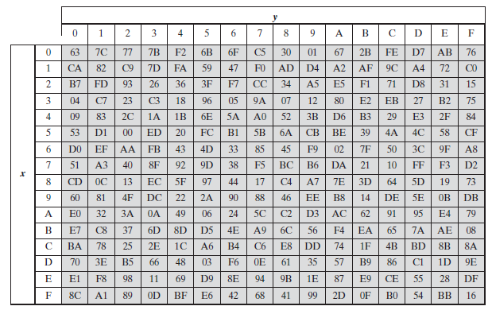
Figure 5. AES S Box

Slide 13
During Decryption
Inverse S-box is used for substitution
C2 = Inverse-S-box(25)

Slide 14
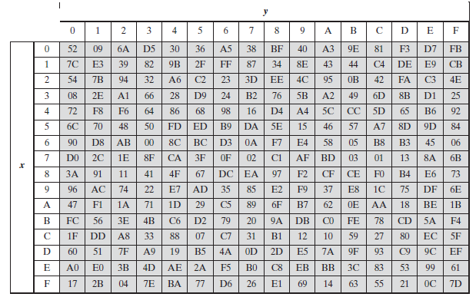
Figure 6. AES Inverse S Box

Slide 15
Static S-box
That means the same S-box will be used in each round.
Fixed S Box allows the attackers to study S-box and find weak points for attacking
Its called offline analysis
Key dependent S Box
In order to prevent this key dependent S Boxes can be used
The S-box changes in each round depending on the round key
It makes it harder for attacker to do any offline analysis of an attack of one particular set of S-boxes (again the round key will be secret so as the S Box)
By making S box key dependent we assume that AES will become stronger

Slide 16
New Proposed AES Design
New design is similar to the original AES
The difference is
Original AES consists of 4 stages while in this new design, it consists of 5 stages
The extra stage is known as S-Box Rotation :
A new S Box is created for each round (Dynamic) using the round key for that round
It is introduced at the beginning of the round function.
The remaining four stages are unchanged as it is in AES.
This new S Box is used for substitution

Slide 17
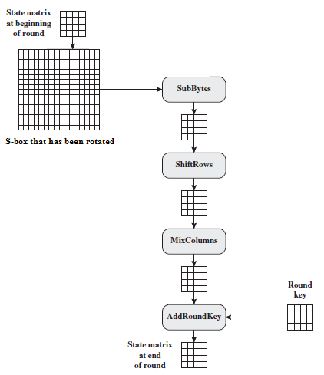
Figure 7. New proposed key-dependent Encryption algorithm One round

Slide 18
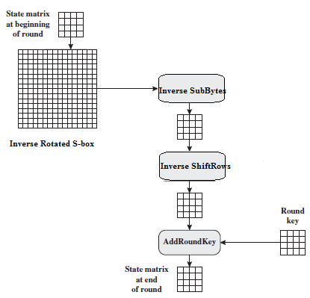
Figure 8. New proposed key-dependent Decryption algorithm One round

Slide 19
Key-Dependent S-Box Generation
By Rotation of the bytes in the fixed S box in each rounds
The round key generated will be used for finding a value that is used to rotate the S-box.
Rotation means shifting the bytes to the right ‘r’ number of times
Where ‘r’ is the value found out using round key

Slide 20
Suppose for a particular round n, if the round key value is
7D558EAC0E403CD82D95275E37199246 (in Hex)
Apply XOR operation on all the bytes.
7D+55+8E+AC+0E+40+3C+D8+2D+95+27+5E+37+19+92+46 = 9B (+ symbol used for XOR) (hex)
We will next rotate the original S-box, to the right by a value say 155(or 9B in Hex).
The resulting rotated S Box can be used for substitute byte stage in that round
For another round the S Box will be again rotated
Similarly we can create the key dependent inverse S Box for that round also applying the same method on the original inverse S Box
The rotation value is now dependent on the entire round key
This property holds for all possible 256 rotations

Slide 21
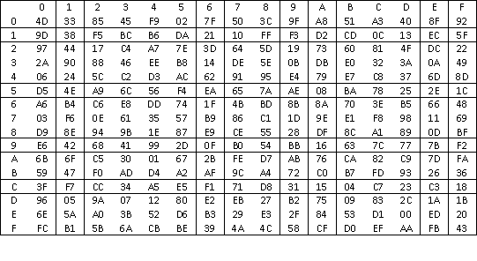
Figure 9. Rotated S Box. 9B hex times to the right

Slide 22
Evaluation Criteria
A good Block cipher must withstand cryptanalysis
Rijndeal has been cryptanalyzed ever since it became AES
And it was proven to be stronger against almost all classical cryptanalysis
So this proposed design also should be tested in order to make sure that It follows the AES security standards
We will perform two main evaluation tests
NIST Statistical Test (16 tests)
Cryptanalysis Attack
The Data should pass all the 16 NIST Statistical tests
The main test is frequency test
All data should pass this test before proceeding to other 15 tests
If it fails for frequency test it fails for 16 tests.

Slide 23
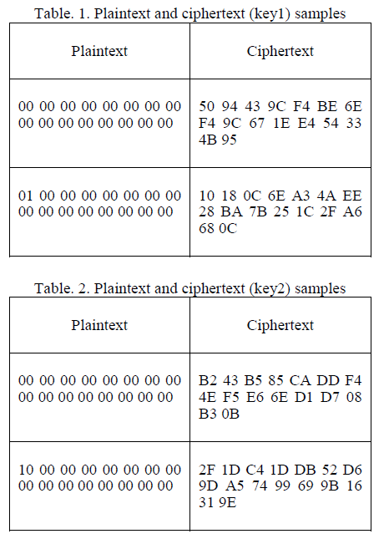
Experimental Result

Slide 24
20000 samples were prepared for new proposed algorithm.
Encryption is done with 2 different keys and the ciphers has been observed as shown in Table. 1 and Table. 2.

Slide 25
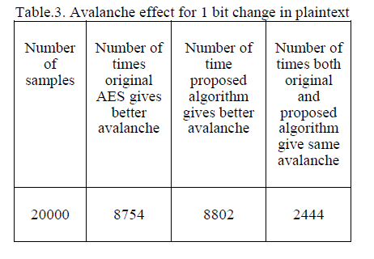
Avalanche Effect Measurements

Slide 26
A small change in the plaintext or key that give a large changes in the cipher text is known as Avalanche Effect
A block cipher is said to have a poor randomization if it does not exhibit the avalanche effect to a significant degree
For a good quality block cipher, such a small change in either key or plaintext should cause a drastic change in the cipher text.

Slide 27
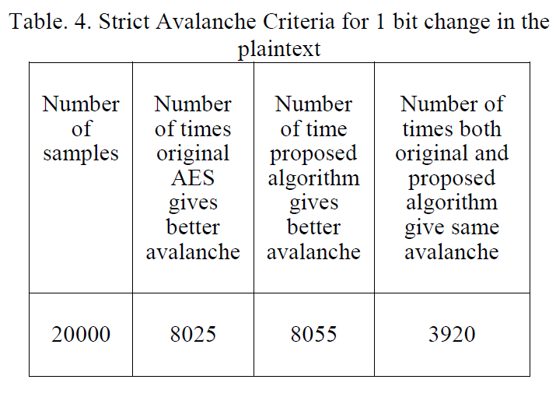
Strict Avalanche Criterion (SAC)

Slide 28
A function is said to satisfy the strict avalanche criterion SAC, if whenever a single input bit is complemented, each of the output bits should change with a probability of one half
To measure confusion and diffusion, the Strict Avalanche Criterion (SAC) test is presented, together with its results. Table. 4 show the SAC by changing one bit of plaintext in the samples.
Results show that the enhancement on the original AES does not violate the security of the cipher. The enhanced version introduces confusion without violating the diffusion property.

Slide 29
Future Enhancements
AES is strong enough to prevent classical attacks such as cryptanalysis
However since AES is very algebraic, new type of algebraic attacks are present now
After the new proposed algorithm successfully passes the 16 statistical tests, we will perform one cryptanalysis attack, which is the algebraic attack in attempt to break the cipher and test the security of this new design.
Speed of the algorithm also needs to be tested, and optimized.

Slide 30
Conclusion
A new design for enhancing the security of AES algorithm is proposed.
This approach design will not contradict the security of the cipher (Diffusion and Confusion, Avalanche etc.)
We try to improve the security of AES by making its S-box to be key-dependent.
Researchers hope to perform cryptanalysis attack (algebraic attack) on this new algorithm as part of the evaluation test.
The result of the cryptanalysis attack will help in permitting its subversion with improved security

Slide 31
References
[1] Trappe, W. and Washington, L. C.: Introduction to Cryptography with Coding Theory. United States: Prentice Hall, (2002).
[2] Daemen, J., and Rijmen, V.: The block cipher Rijndael. Proceedings of the Third International Conference on smart card Reseacrh and Applications, CARDIS'98, 1820, pp. 277-284, Berlin: Springer, (2000).
[3] Stallings, W.: Cryptography and Network Security, Prentice Hall, (2010).
[4] Daemen, J. and Rijmen, V.: The First 10 Years of Advanced Encryption. In IEEE Security and Privacy, vol. 8, pp. 72-74, November (2010).
[5] Federal Information Processing Standards Publications FIPS 197, Advanced Encryption Standard (AES), 26 Nov (2001).
[6] Fahmy, A., Shaarawy, M., El-Hadad, K., Salama, G., and Hassanain, K.: A Proposal For A Key-Dependent AES. 3rd International Conference: Sciences of Electronic, Technologies of Information and Telecommunications. Tunisia: SETIT (2005).
[7] Sagheer, A. M., Al-Rawi, S. S., Dawood., A. O.: Proposing of Developed Advance encryption Standard. Developments in E-systems Engineering (DeSE), pp197-202 (2011).

Slide 32
[8] Zhang, R., and Zhen, L.: A Block Cipher using key-dependent S-box and P-Box. ISIE 2008 IEEE International Symposium on Industrial Electronics, pp. 1463-1468 (2008).
[9] Sulaiman, S., Muda, Z., and Juremi, J.: A Proposed Approach of Key Scheduling Transformation. In Cyber Security Cyber Warfare and Digital Forensic(CyberSec), 2012 International Conference, pp. (2012).
[10] Krishnamurthy, G. N., and Ramasvamy, V.: Making AES Stronger:AES with Key Dependent S-Box. IJCSNS International Journal of Computer Science and Network Security, vol.8, pp. 388-398 (2008).
[11] Schneier, B.: Description of a New Variable Length Key, 64-Bit Block Cipher (Blowfish), Fast Software Encryption,” Cambridge Security Workshop Proceedings, pp. 191-204, Springer-Verlag (1994).
[12] Schneier, B., Kelsey, J., Whiting, D., Wagner, D., Hall, C., and Ferguson, N.: The Twofish Encryption Algorithm. Proc. 1st Advanced Encryption Standard (AES) Conference (1998).
[13] Rukhin, A., et al.: A Statistical Test Suite for Random and Pseudorandom Number Generators for Cryptographic Applications. NIST Special Publication 800-22 (2001).
[14] Forre, R.: The strict avalanche criterion: spectral properties of booleans functions and an extended definition. Advances in cryptology, in: S.Goldwasser(Ed), Crypto’88, Lecture Notes in Computer Science, vol.403, Springer-Verlag, pp.450-468 (1990).
[15] Ferguson, N., Schroeppel, R., and Whiting, D.: A simple algebraic representation of Rijndael. Selected Areas in Cryptography, pp. 103-111 (2001).

Slide 33
Questions?

Slide 34
THANK YOU..

